Slide 1
Monitoring and Assessing Sustainable Development
The Swiss Experience
François Baumgartner, FSO Deputy Director
OWG Informal Meeting on Measuring Progress, New York, 17 December 2013

Slide 2
Importance of a conceptual framework
1. How well do we live?
(Quality of life)
2. How well are resources distributed?
(fairness, equity)
3. What are we leaving behind for our children?
(Capital stocks)
4. How efficiently are we using our natural resources?
(resource efficiency)

Slide 3
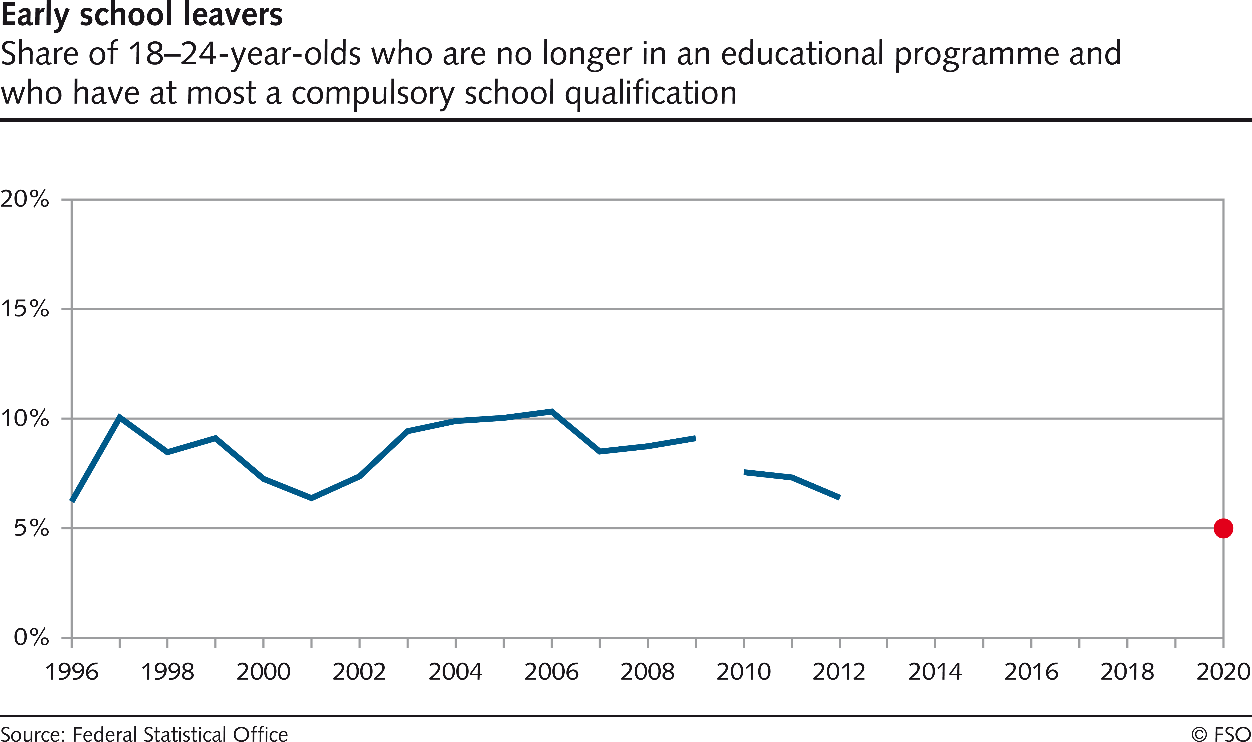
What are we leaving behind for our children? Example: Early school leavers

Slide 4
Importance of a conceptual framework
1. How well do we live?
(Quality of life)
2. How well are resources distributed?
(fairness, equity)
3. What are we leaving behind for our children?
(Capital stocks)
4. How efficiently are we using our natural resources?
(resource efficiency)

Slide 5
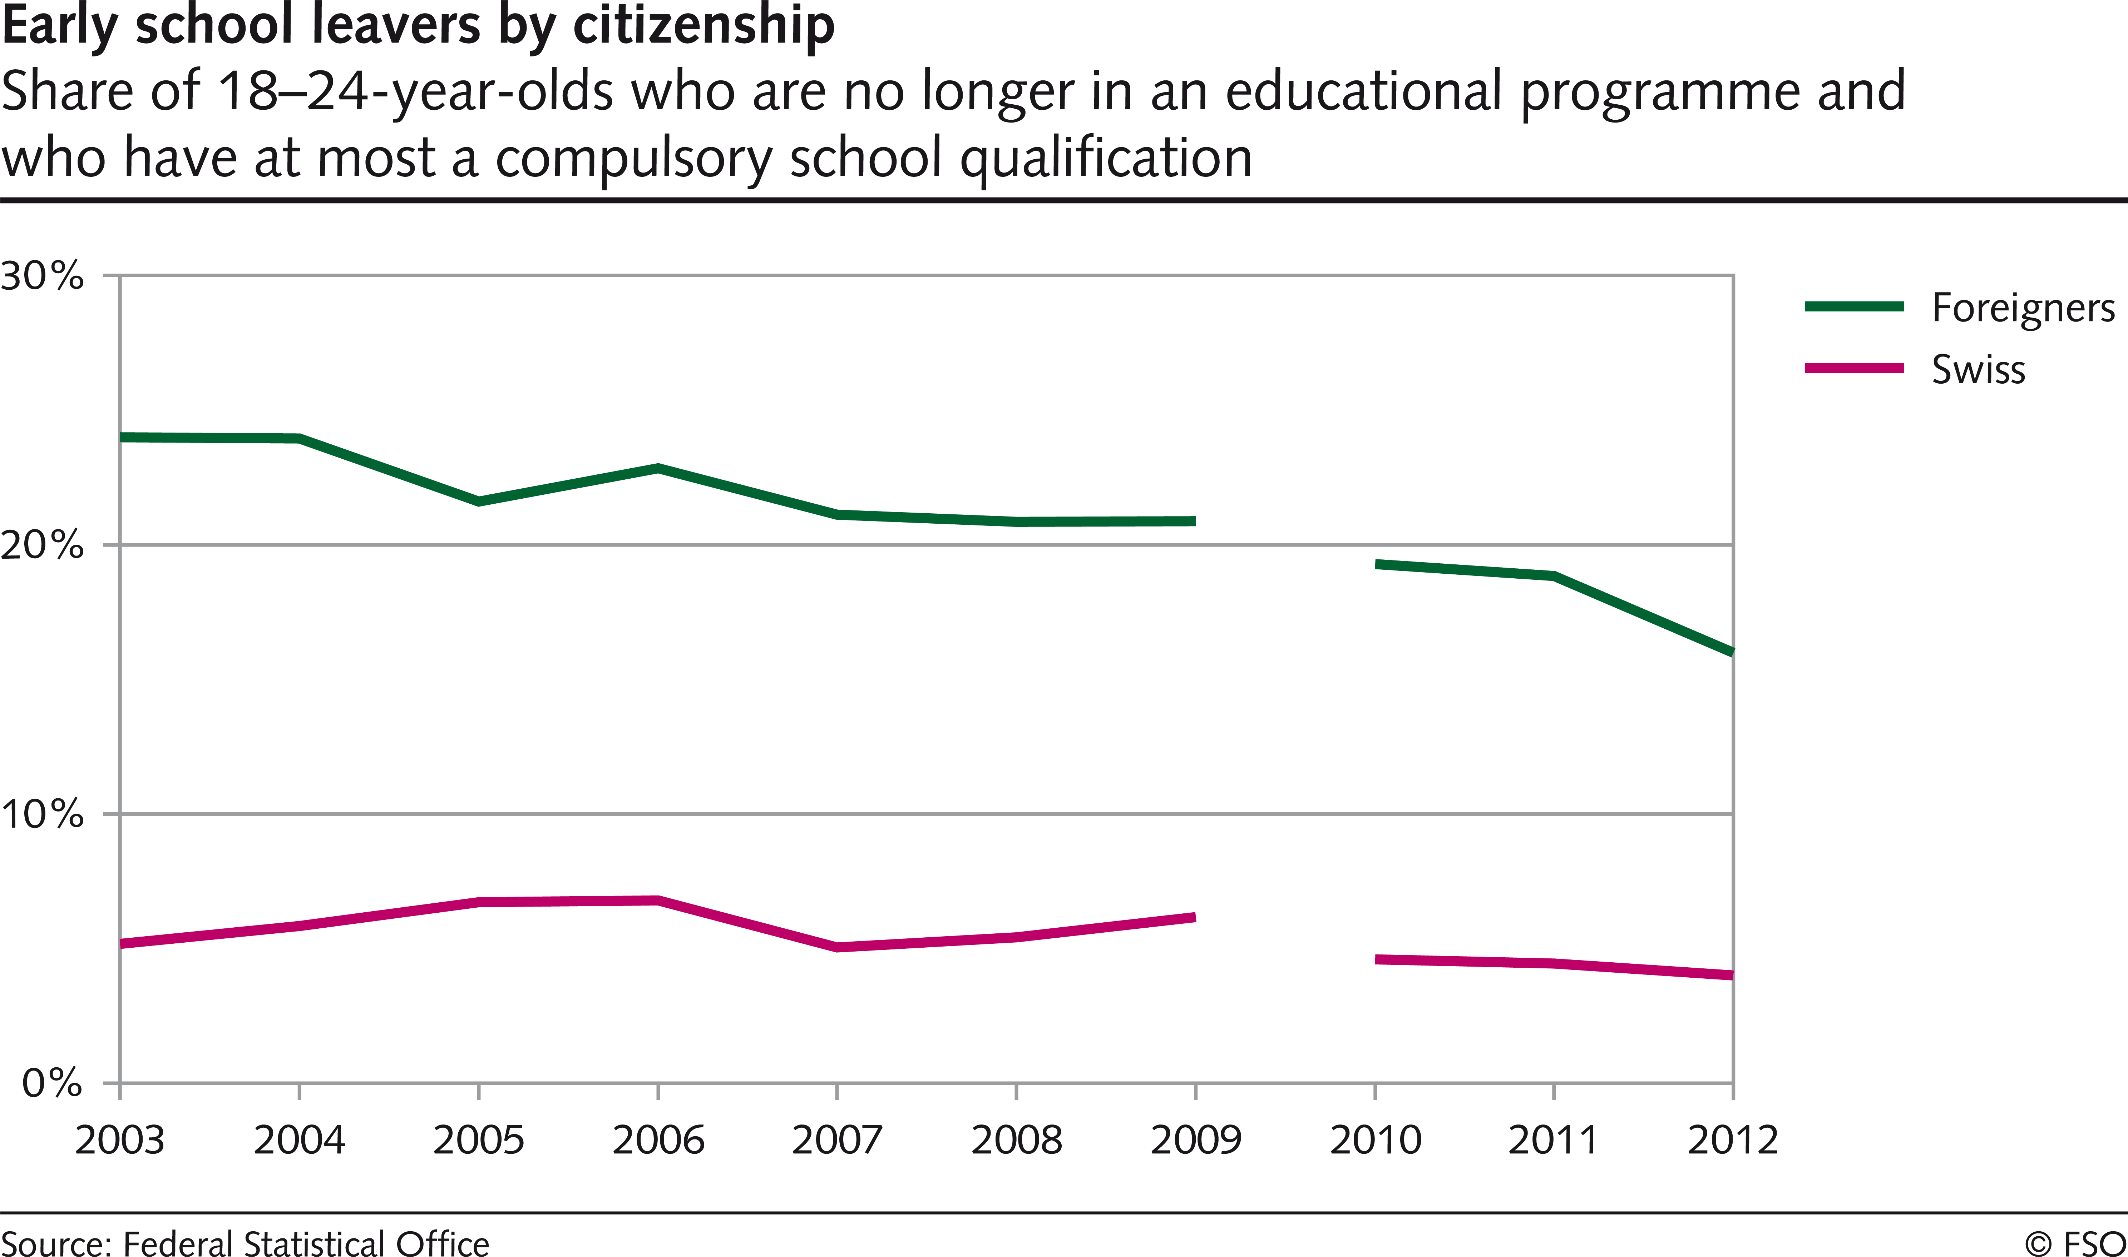
How well are resources distributed? Example: Early school leavers by nationality

Slide 6
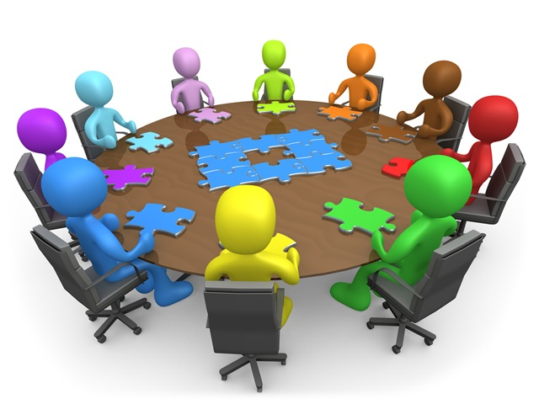
Need for a dialogue between policy-makers and statisticians

